Slide 1

College Preparatory
Senior Orientation

Slide 2
Senior Students
Students M-Z
Mr. Samoyedny
samoyednyj@hasdk12.org
Students A-L
Mr. Corrado
corradod@hasdk12.org

Slide 3



Congratulations!
CLASS OF 2021
You’ve made it! LAST YEAR
Do NOT Limit Yourself
Enjoy this year and continue to make good decisions

Slide 4


SELECTING A COLLEGE
Major / Do they have what you are looking for?
Location / Distance
Cost / Schools range from $2,500 to $60,000 per yr.
Academic Criteria
Size

Slide 5



Slide 6

Not sure what to study?
https://www.mynextmove.org/
Take an inventory that matches your interests to careers.
Updated by the U.S Department of Labor

Slide 7


















Location
How far away?
How far away does my family want me?
PA has many great colleges.
Out of state tuition is usually doubled.
Laundry… Cooking ?!?!

Slide 8
4 YR College
2 YR College
LEAD TO
LEAD TO
Bachelor
Master
Doctoral
Associate
Certificate
Community Colleges offer 2-year associates to transfer to a college to earn a bachelor's.
Also, offers certificates for a careers that are affordable. SAT usually not required.
Liberal Arts College
Literature, History, Languages, Math and Life Sciences. Most are private and may cost more.
Universities are larger and offer more majors and degrees.
Most contain smaller colleges, such as:
Colleges of Liberal Arts, Engineering or Health Sciences.
Vocational-Technical and Career Colleges offer specialized training in a particular industry.
Example: Culinary, Firefighting, Dental Hygiene and Medical-Records. Usually offer certificates or associate degrees.

Slide 9

Majors
(specific subject area that you specialize in)
Keep options open
Think of past experiences
Where do I want to live in the future?
How many years of school ?
What am I good at?
What subjects do I like?
How many hours per day do I want to work?
What kind of salary do I want to make?

Slide 10
Popular / Valuable Majors
MAJOR | MEDIAN SALARY | GROWTH BY 2020
Pharmacology | $105,000 | 25%
Aeronautics & Aviation Tech. | $60,000 | 5%
Physical Therapy | $60,000 | 33%
Nursing | $60,000 | 26%
Construction Mgt. | $50,000 | 17%
Electrical Engineering | $60,000 | 6%
Medical Technology | $50,000 | 13%
Medical Assistance | $50,000 | 13%
Chemical Engineering | $75,000 | 6%
Computer Info. Systems | $60,000 | 18%

Slide 11

Unsure what to major in?
www.choices360.com
Interest survey
Hundreds of careers
Hundreds of colleges, universities, trade schools, and technical schools
Onet is another great tool for searching for careers

Slide 12


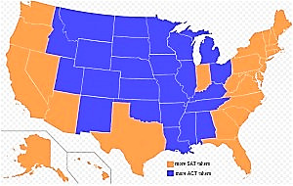
Academic Criteria
Grades
Class Rank
SAT or ACT Scores
Essay
Accomplishments
Letters of Recommendation
Personal Statement?
SAT VS ACT Popularity
Orange is SAT
Blue is ACT

Slide 13


SAT measures what you know and how well you can apply it. It’s considered an aptitude test, measuring reasoning and verbal abilities.
Two sections:
1. Evidence-based Reading and Writing.
2. Math.
Length of the test is 3 hours and 45 minutes.
Scores range from 400-1600 for combined score.

Slide 14
SAT Writing Optional
“Essay”
If you choose to take the essay, it will be its own section of the SAT, and the score you get on the essay will be separate from your score on the rest of the exam.
Your main SAT score will be out of 1600 while your essay will be graded across three different categories:
Reading, Analysis, and Writing.
For each area, your essay will be given a score from 2-8.
Schools that require essay:
https://blog.prepscholar.com/schools-that-require-the-sat-essay

Slide 15
SAT Writing Optional
If even one school you’re interested in requires the SAT essay, then you should take it, regardless of any other factors.
There is no way to take just the SAT essay by itself, so if you take the SAT without the essay and then, later on, realize you need an essay score for a school you’re applying to, you will have to retake the entire test.
Schools that require essay:
https://blog.prepscholar.com/schools-that-require-the-sat-essay

Slide 16

Subject Tests
Subject tests – test in one particular area.
Science, Math, History, Languages
Post-secondary school will require if necessary.
SAT Subject Tests are college admission exams on specific subjects. These are the only national admission tests where you choose the tests that best showcase your strengths and interests

Slide 17
Subject Tests
Each Subject Test is an hour long. They are all multiple-choice and scored on a 200–800 scale.
Subject Tests test you on your knowledge of subjects on a high school level. The best way to prepare is to take the relevant courses and work hard in them.

Slide 18
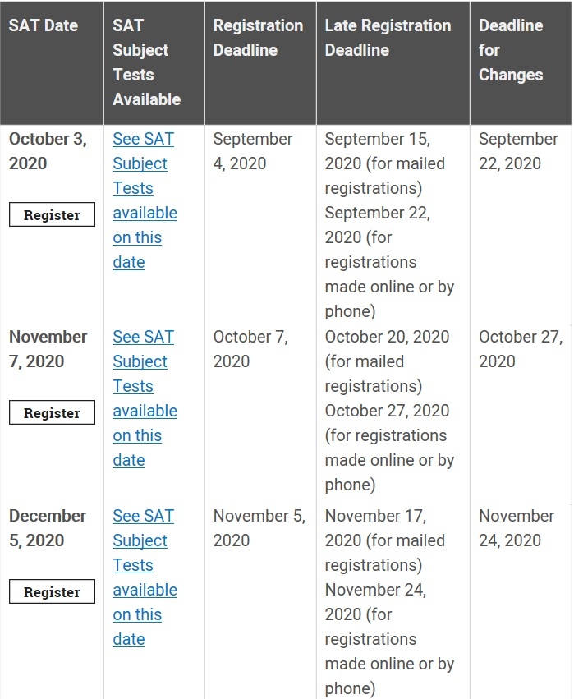

Slide 19
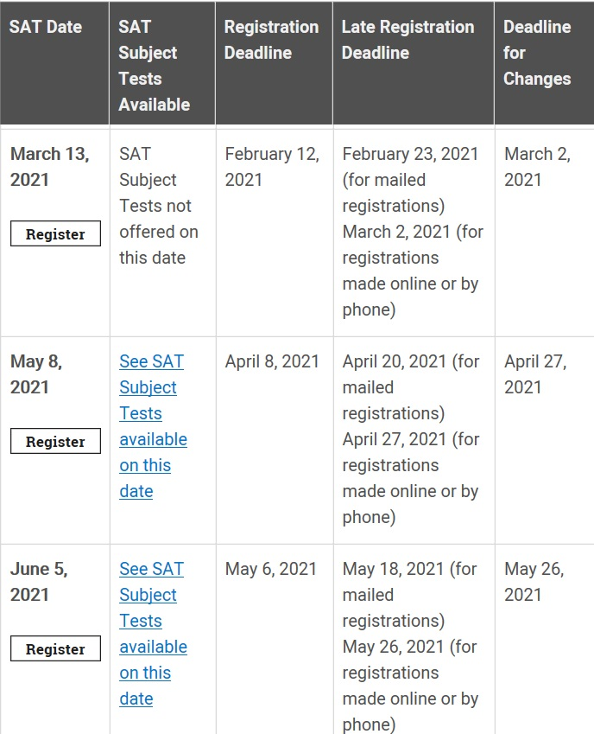

Slide 20

G o o d N e w s
Many schools are waiving the SAT
You could find out from viewing their website or by calling their admissions office
If they are waiving it, and you already taken the SAT, you do not need to send your scores
If the school is waiving the SAT and/or you are not sending SAT scores- you would apply by selecting ‘Test Optional’

Slide 21

ACT has up to 5 sections:
English, Math, Reading, Science, and an optional Writing test.
ACT is an achievement test measuring what a student has learned in school
Test length is 4 hours.

Slide 22

Sending SAT Scores to Colleges
Using Your Collegeboard Account
On your dashboard, you'll see your latest scores front and center: Then, click on the "View Details" button to see your full report. At the top of the report, there are four tabs: Click on the "Score Sends" tab to get to a screen with a button that says "Send Additional Score Reports," and click on that button

Slide 23

Can you submit SAT scores after applying?
Yes, the scores will be accepted and considered so long as they arrive during the evaluation period.
Assuming that your scores are missing, and that you are not sending in a second set of scores, many schools that require SAT scores will not evaluate your application until the application is complete.

Slide 24
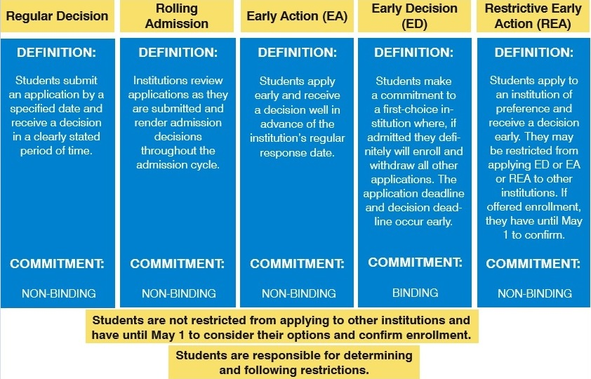

Slide 25

College Visits
Group visit = good
Private tour and interview = better
Sleepover, class visit, professor chat, student mingling, cafeteria lunch = best
Top College Interview Tips
Have a conversation. Don't try to memorize a script.
Ask questions. Do express your interest in the college.
Be yourself. Don't try to answer questions based on what you think the interviewer wants to hear.
Prepare. Do practice interviews with friends or family. Take turns asking questions.
Your interviewer will expect you to ask some questions about the school and talk about why you want to go there

Slide 26


Guidance Announcement Link:
https://www.hasdk12.org/Domain/744

Slide 27
Virtual College Visits
Keystone College:October 8th at10:00am
Pennsylvania College of Technology: October 13th at 11:00am
King's College:October 14th at 10:00am
Penn State University:October 16th at 10:00am
Lafayette College: October 19th at 10:00am
Tuft University:October 28th at 11:00am
Indiana University of Pennsylvania: October 21st at 11:00am
East Stroudsburg University: October 22nd at 1:30pm
Lock Haven University: October 23rd at 11:00am
Muhlenberg College: October 27th at 10:30am
Universal Tech Institute: October 28th10am
Harrisburg University: October 29th 1:00pm
VertoEducation / Study Abroad -Nov 5,10AM
Email Nina at HAHSGUIDANCE@HASDK12.ORG for the meeting's link/invite.

Slide 28

Things to do
Start sending out applications to post-secondary schools
You should have already
Acquired information on post-secondary schools you are interested in. Suggestion 4-5 schools!
Taken SATs or ACTs.
Checked credits with your Guidance Counselor.
If you are an 18 yr old male you must register for selective service to receive any financial aid.

Slide 29
Resources for Applications
Guidance webpage
www.collegeboard.com
www.commonapp.org
Any school’s official website (“edu.” will be at the end of a school’s web address).

Slide 30

What is the
?
Connect To More
No other system matches the diversity of colleges and universities accessible through the Common App. Explore and apply to schools across the world.
Work Smarter
There is no need to repeat your applicant details for every college on your list. Enter your information one time and use it to apply to multiple schools.
Stay On Track
Our system alerts you when important dates are approaching. Manage your deadlines and view application progress in one convenient dashboard.

Slide 31
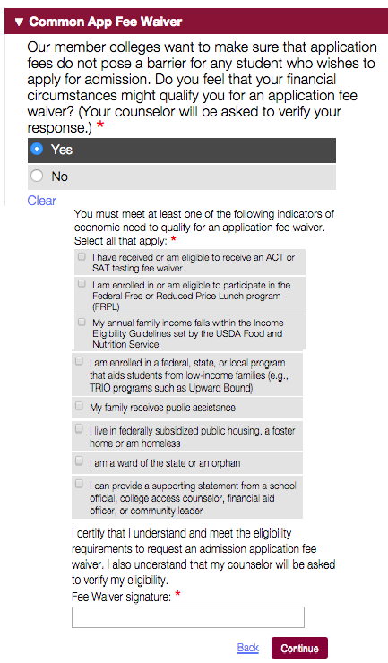
Fee Waivers for
College Applications
By Using Common App
You’ll electronically sign this section, as well as receive the above reminder that your counselor will need to confirm your answer. If you already got an SAT or ACT fee waiver, then your counselor should be able to sign off on this automatically.

Slide 32
Fee Waivers for College Applications By Using Collegeboard
If you took the SAT or one or more SAT Subject Tests with a fee waiver, then you’ll automatically get four college fee waivers from College Board.
These college app fee waivers will become available through your College Board account.
You just have to log in and click on “Apply to college for free.”
Once there, you can access and, if your college requests it, print out and send your fee waivers.
If you took the SAT as a senior, then you’ll be able to access these waivers when your scores become available.
If you took the SAT as a junior, then you’ll have to wait until the fall of senior year.

Slide 33

Applying continued
Complete any essay questions.
Give yourself enough time.
If applying to PSU Early Action: Nov 15th Deadline.
Nursing deadlines differ at every post-secondary school.
Are you Self Reporting? You will see the acronym SAR “Student Aid Report”
If so, you could find your grades in the grade history section on your Skyward account.

Slide 34
Financial Aid Night, Oct. 20th
Do you need help with your FAFSA or have no clue what it is?
A higher education access partner from PHEAA, Robin Walker, will be hosting a free, virtual financial aid night on Tuesday, October 20th. The first session will focus on financial aid from 6PM to 7PM. The second session will focus on FAFSA completion from 7:30-8:30. You and a parent/guardian will need your FSA ID for this session. (A video with directions is below this announcement). Please ​email Nina at HAHSGUIDANCE@HASDK12.ORG to register for either or both sessions.
This is a perfect opportunity for you and a parent/guardian to complete your FAFSA for college!

Slide 35

Did you miss the financial aid night?
Good news, it was recorded:
https://www.hasdk12.org/Domain/744
Password: hZEimmA6

Slide 36

What is the FAFSA?
Free Application for Federal Student Aid
(FAFSA®) form to apply for financial aid for college or graduate school.

Slide 37
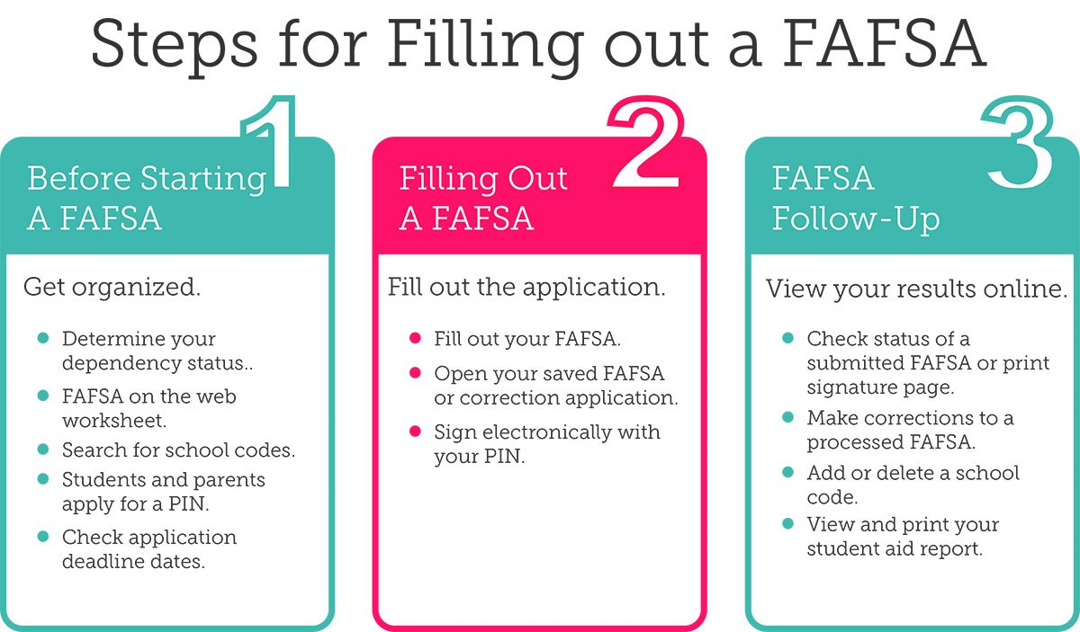
YOU WILL NEED YOUR FAMILIES 2019 W2 TAX STATEMENTS

Slide 38


Responsibilities
Assuring all credit requirements are met for high school to graduate.
Obtaining 28 credits
4 Mathematics, 4 English/ELD, 4 Social Studies, 4 Sciences, 2 PE
& 10 Electives/Languages
Making sure you meet the requirements for the college and deadlines.
Apply as early as possible.
Some colleges will expect at least 2-3 years of a language on your transcript.

Slide 39
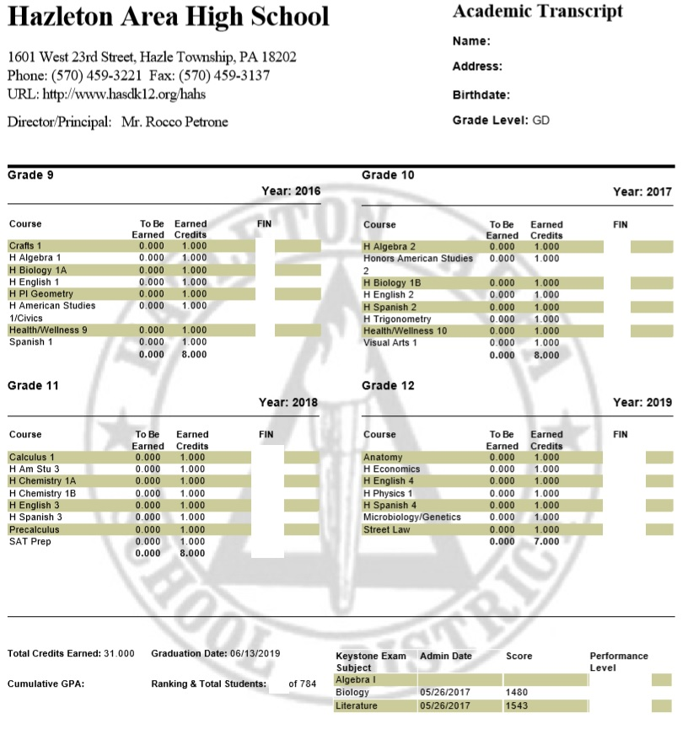

Slide 40



$cholarships
Listen for announcements
www.fastweb.com
www.choices360.com
www.questbridge.org
Guidance office
Standard Speaker
HAHS website
https://www.hasdk12.org/Page/26433

Slide 41

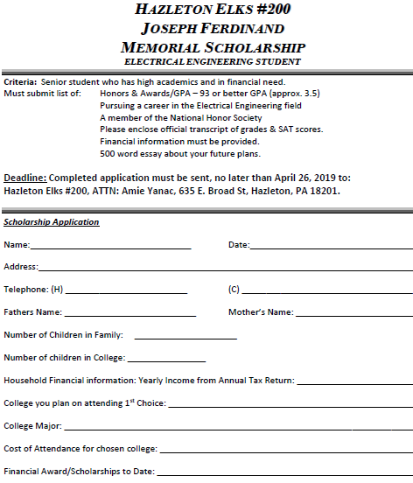
Example
$cholarship

Slide 42

State and Federal Aid
You can apply for PHEAA (State) and Pell (US Govt) Grants after October 1st 2020. .
Create a FSA ID. You can do this before applying for FAFSA. Having this ID is the only way to access your data online. (You and a parent/guardian will need a FSA ID).
Acquire your FAFSA application and FSA ID on: https://studentaid.gov/

Slide 43
Personal Email
Do not use your high school email when entering an email for college applications and the FAFSA.
Your incoming messages may be blocked by our school, since it would be an outside email.
You should use a personal email that you check frequently.
Make it formal.

